Slide 1
SENTIMENT ANALYSIS
CAPSTONE PROJECT
Presented By:
Student Name – G.SURYA JAGADEESWARARAO
College Name – KRISHNA UNIVERSITY COLLEGE OF ENGINEERING AND TECHNOLOGY
Department – COMPUTER SCIENCE & ENGINEERING

Slide 2
OUTLINE
Problem Statement (Should not include solution)
Proposed System/Solution
System Development Approach (Technology Used)
Algorithm & Deployment
Result
Conclusion
Future Scope
References

Slide 3
Problem Statement
Develop a Sentiment Analysis Model to classify Restaurant Reviews as Positive or Negative
DESCRIPTION :
With the rapid growth of online platform for sharing opinions and Reviews , Restaurants often rely
On the Customer Feedback to improve their services and attract a new Customers.
Analysing the Sentiment of these Reviews can provide valuable insights into Customer Satisfaction.

Slide 4
Proposed Solution
The proposed system aims to address the challenge of predicting the required on Restaurant Reviews and Likes.
This involves leveraging data analytics and machine learning techniques to forecast demand patterns accurately.
The solution will consist of the following components:
Data Collection:
Gather Reviews Data on Restaurant .
Utilize real-time data sources, such as Likes, Positive Reviews, Negative Reviews to enhance prediction accuracy.
Data Preprocessing:
Clean and preprocess the collected data to handle missing values, outliers, and inconsistencies.
Machine Learning Algorithm:
Implement a machine learning algorithm, such as a NAIVE BAYES ALGORITHM, TF – IDF ALGORITHM , to predict the Probability of every object, its features ,& which groups they belong to .
Deployment:
Develop a user-friendly interface or application that provides real-time predictions for Restaurant Reviews.
Evaluation:
Assess the model's performance using appropriate metrics such as ACCURACY_SCORE, CLASSIFICATION_REPORT.
Result: Accuracy :- 0.8

Slide 5
System Approach
SYSTEM REQUIREMENTS
WINDOWS 10 OPERATING SYSTEM
ANACONDA Software
JUPYTER NOTEBOOK
PYTHON 3 Version
LIBRARY REQUIRED TO BUILD THE MODEL
pandas : Used for Working with Data Sets .
NumPy : Used for Working with Arrays .
Sklearn : To implement Machine Learning Models and Statistical Modeling .
nltk : (Natural Language Tool Kit) –To preprocess text data for further analysis like with ML Models .
matplotlib : A comprehensive library for Creating Static , Animated , & Interactive Visualizations in Python .
WordCloud : Used to Create Word Cloud .
BeautifulSoup : This makes it easy to scrape information from Web pages .
Seaborn : For making Statistical Graphics in Python .

Slide 6
Algorithm & Deployment
In the Algorithm section, describe the machine learning algorithm chosen for predicting Restaurant Reviews .
Here's an example structure for this section:
Algorithm Selection:
Chosen Algorithm : NAIVE BAYES ALGORITHM –Used for Classification Problems .It is highly used in Text Classification . In text classification tasks , data contains high dimension . It is used in Spam Filtering , Sentiment Detection , Rating Classification etc.
Benefits : Naive Bayes Algorithm gives a Fast and Highly Scalable Model for Building and Scoring .
Data Input:
Input Features used by the algorithm , Such as Positive Reviews , Negative Reviews , Likes.
Purpose : The purpose of Data Input is to provide the algorithm with examples of text and their associated sentiment labels (eg. Positive, Negative , Neutral).
Training Process:
Training Process enables machine learning models to accurately classify the sentiment of text inputs.
Benefits : Learning Patterns, Extraction , etc.
Prediction Process:
Train_Test_Split technique is used to estimate the performance of machine learning algorithm which are used to make predictions on data . It controls the random number generator used to shuffle the data before splitting it.

Slide 7
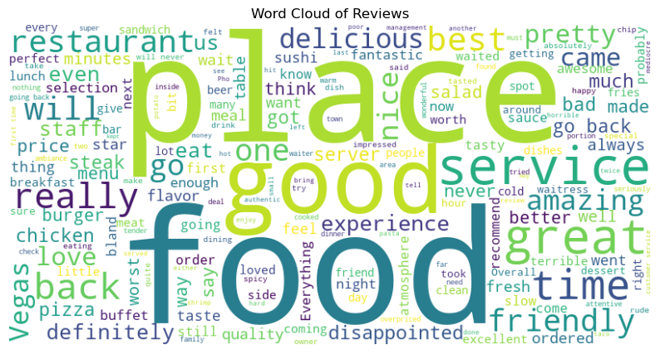
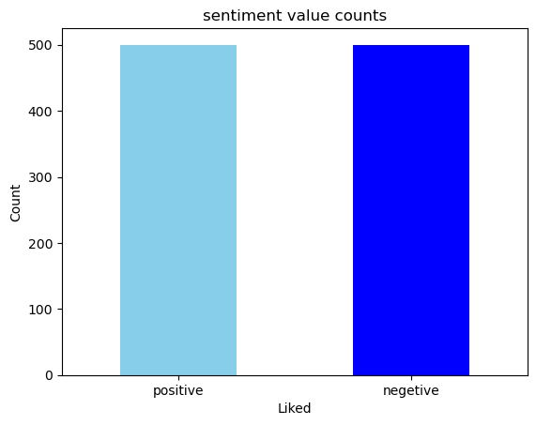
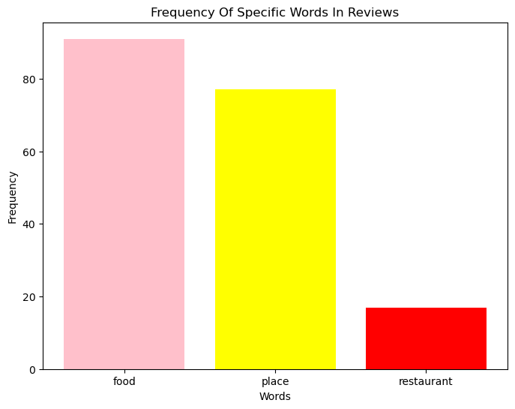
Result
WordCloud Plot: It is a data visualization technique used to representing text data in which the size of each word indicates its frequency or importance.
(shown in fig 2)
values_count_plt : It is used to show the total count of the particular value in bar graph.
Positive Reviews : Sky Blue
Negative Reviews : Blue
(shown in fig 1)
Fig 1: Value Count Plot
Fig 2: WordCloud Plot
Target_Word_Count_plt: Used to count the length of the given particular words in the list (e.g. Food, Place , Restaurant)
Food : Pink
Place : Yellow
Restaurant : Red
( shown in fig 3)
Fig 3: Target Word Count Plot

Slide 8
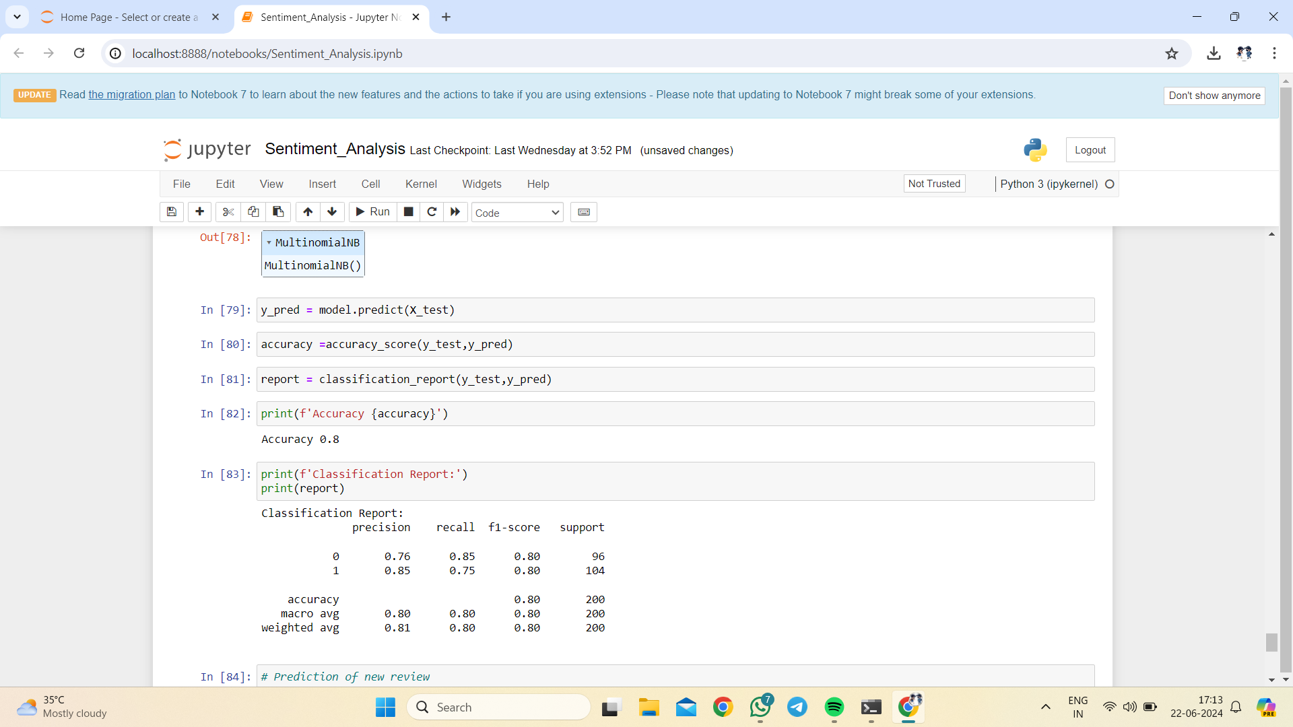
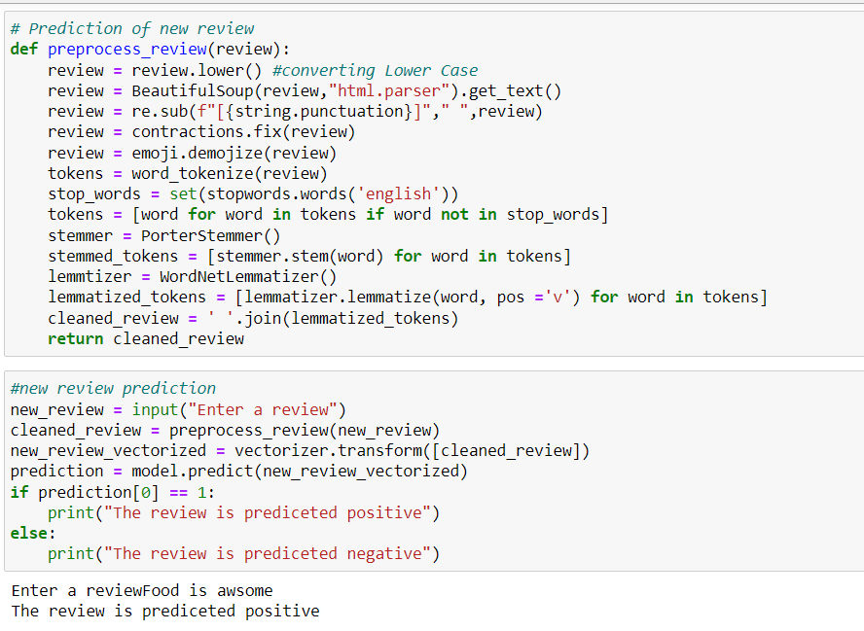
ACCURACY :
Accuracy is a metric that measures how often a machine learning model correctly predicts the outcomes.
CLASSIFICATION REPORT :
In classification report , we can see things like accuracy , which tells us overall how often our model is correct. We also see Precision , Recall , & F1 score ,which give us insights into how well our model is doing at correctly identifying different classes.
For my data Accuracy: 0.8 (shown in fig 4)
Fig 4 : Accuracy & Classification Report
PREDICTION :
It refers to the output of an algorithm after it has been trained on a historical dataset and applied to new data when forecasting the likelihood of a particular outcome.
When u enter a review it checks that review and gives the result as positive or negative. (shown in fig 5)
Fig 5 : New Review Prediction

Slide 9
Sentiment Analysis can be applied to tasks such as Text Classification and Summarization.
The scope of sentiment analysis refers to the ability to assess the Authoritativeness and Convincing ability of a user’s sentiment on a topic in a social network.
However, sentiment analysis will delve deeper in the future , beyond the concept of Positive , Negative , or Neutral , to reach and comprehend the significance of understanding conversations and what they reveal about consumers.
Future scope

Slide 10
References
Learning Portal –IBM SKILLBUILT
Edunet –TN-Machine Learning to Generative AI – Link - https://skills.yourlearning.ibm.com/activity/PLAN-3E9AB40DB051
Research Papers :
Liu . B. (2012). Sentiment Analysis and Opinion Mining .
Pang, B ., & Lee, L. (2008). Machine Learning Algorithms for Sentiment Analysis : A Survey.
Documentation :
Scikit – learn : scikit-learn Documentation.
NLTK(Natural Language Tool Kit) :NLTK Documentation .
Online Articles :
A Begineer’s Guide to Text Classification in Python. Machine learning Mastery
Practical Guide to Implement Sentiment analysis in Python . Towards Data Science.

Slide 11
Conclusion
Sentiment Analysis uses Machine Learning (ML) to understand the data.
Sentiment analysis is a method that is used to detect the state of some information or text.
The overall Accuracy and Precision of the operation are maximized to help businesses process the information on different criteria without getting complicated.
In this project we relies on customer review data to understand how consumers socially engage.
Sentiment analysis uses NLP to break down reviews and classify them as Positive , Negative , or Neutral.

Slide 12
THANK YOU

